Slide 1


BANC: Towards Efficient Binaural Audio Neural Codec for Overlapping Speech Anton Ratnarajah, Shi-Xiong Zhang, Dong Yu
Presenter : Anton Jeran Ratnarajah (University of Maryland, College Park)

Slide 2
Neural Audio Codec
Neural audio codecs are used to compress audio signals into codes to reduce the amount of data transmitted or stored.
The end-to-end data-driven neural audio codecs does not assume the nature of the input training dataset, allowing it to generalize to any audio content.
Most neural audio codecs are composed of encoder, quantizer and decoder modules.

Slide 3
Neural Audio Codec
Two major drawbacks are evident in prior neural audio codec designs :
They predominantly focus on single-channel audio processing.
They assume the presence of only one primary speaker within the audio.
To overcome these limitations, we introduce BANC, a novel neural spatial audio codec designed for efficient binaural speech compression. BANC effectively handles both single-speaker and two-speaker scenarios, preserving spatial distinctions across different locations.

Slide 4
Binaural Audio – Single Speaker
A key distinction between single-channel and binaural speech is that the latter incorporates binaural acoustic effects, such as early reflections, late reverberations, and interaural discrepancies like interaural time differences and interaural level differences.
S_{B}[t] = S_{C}[t] * BIR[t]
S_{C}[t] → Clean Speech
BIR → Binaural Acoustic Effect / Binaural Impulse Response
S_{B}[t] → Binaural Speech

Slide 5
Binaural Audio – Two Speaker
For overlapped binaural speech with two speakers in two different spatial locations, we can separately decompose their clean speech content, and their binaural impulse responses as follows :
S_{OB}[t] = (S_{C1}[t] * BIR₁[t]) + (S_{C1}[t] * BIR₁[t])
S_{C1}[t] → Clean Speech from Speaker 1
S_{C2}[t] → Clean Speech from Speaker 2
BIR₁ → Binaural Impulse Response corresponding to Speaker 1
BIR₂ → Binaural Impulse Response corresponding to Speaker 2
S_{OB}[t] → Overlapped Binaural Speech

Slide 6
BANC : Binaural Audio Neural Codec for Overlapping Speech
BANC is a neural audio codec architecture optimized for binaural overlapped speech from two speakers, crucially retaining each speaker’s spatial context.
We propose a novel strategy of separately compressing speech content and spatial cues, ensuring the preservation of each speaker’s spatial context after decoding.
BANC achieves high compression for binaural audio, reconstructing 48 kHz binaural speech from two speakers using only 12.6 kbps, surpassing AudioDec [1], which operates at 24 kbps for binaural speech, while also reducing spatial errors by 52%.
1) Wu et al.,“Audiodec: An open-source streaming high-fidelity neural audio codec,” in ICASSP 2023.

Slide 7
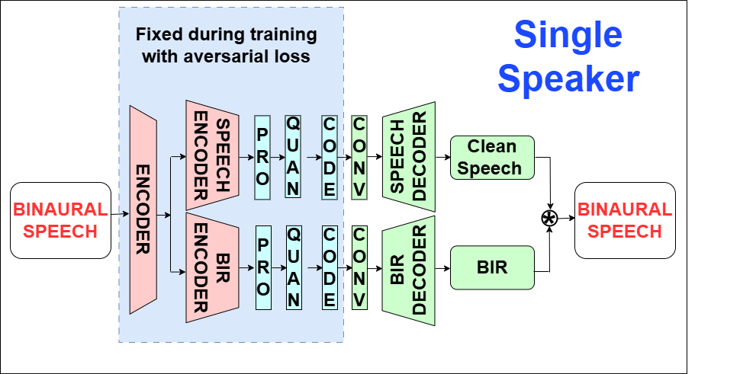
BANC : Single Speaker

Slide 8
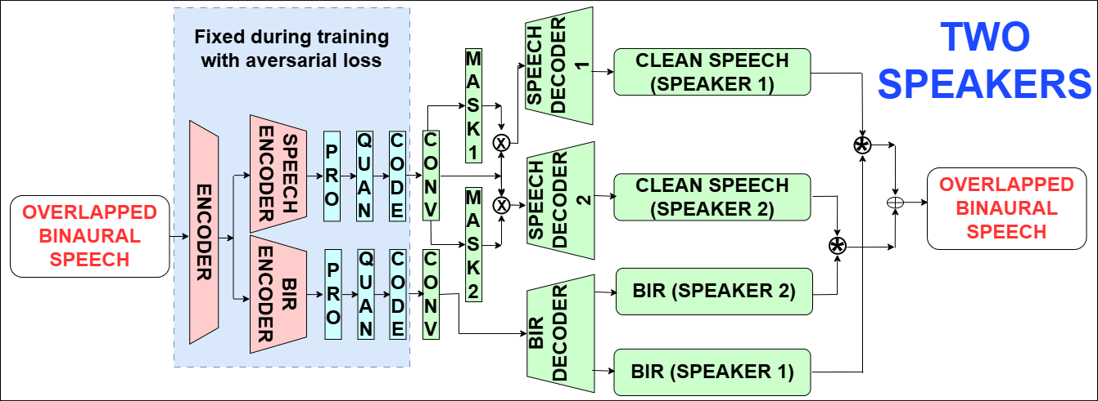
BANC : Two Speakers

Slide 9
Bandwidth
AudioDec allocates 80 bits per frame at a sampling rate of 48,000 Hz and a stride factor of 300, resulting in a bandwidth of 25.6 kbps for binaural speech (2 channels) calculated as 2 × 80 × 48,000 / 300. In contrast, our proposed BANC method compresses the clean speech signal by a factor of 300 and the BIR by 6000, leading to a significantly reduced bit rate of 13.44 kbps, computed as (80 × 48,000 / 300) + (80 × 48,000 / 6000).

Slide 10
Training Paradigm
We adapt the training paradigm proposed in AudioDec [1]. First, we train the end-to-end network with the metric loss for 200k iterations. Then, we replace our speech decoders with HiFi-GAN [2] vocoders and continue training with both the metric and adversarial losses for an additional 500k iterations, using HiFi-GAN-based multi-period and multi scale discriminators.
In the multi-speaker scenario, after 200k iterations, we further train our end-to-end network with adversarial and metric losses for an additional 160k iterations.
Wu et al.,“Audiodec: An open-source streaming high-fidelity neural audio codec,” in ICASSP 2023.
A. van den Oord et al., “Neural discrete representation learning,” in Advances in Neural Information Processing Systems (NeurIPS), vol. 30, Curran Associates, Inc., 2017.

Slide 11
Dataset
We generate binaural speech datasets for both single-speaker and two-speaker scenarios using clean speech from the Valentine dataset [1] and simulated BIRs from Pygsound [2]. We simulated 50k BIRs using Pygsound, which were then randomly convolved with the clean speech corpus using for single-speaker and for two-speaker scenarios. We split the simulated dataset into 33,975 training samples, 750 validation samples, and 752 test samples.
C. Valentini-Botinhao, “Noisy speech database for training speech enhancement algorithms and TTS models,” 2017. [Online]. Available: https://doi.org/10.7488/ds/2117
Z. Tang et al., “Improving reverberant speech training using diffuse acoustic simulation,” in ICASSP 2020

Slide 12
Baselines
Opus [1]
Encodec [2]
HiFi-Codec [3]
AudioDec [4]
1) J.-M. Valin et al., “Definition of the Opus audio codec,” IETF RFC 6716, 2012. 2) A. Défossez et al., “High fidelity neural audio compression,” CoRR, vol. abs/2210.13438, 2022. 3) D. Yang et al., “Hifi-codec: Group-residual vector quantization for high fidelity audio codec,” CoRR, vol. abs/2305.02765, 2023. 4) Y.-C. Wu et al., “Audiodec: An open-source streaming high-fidelity neural audio codec,” in ICASSP 2023, 2023.

Slide 13
Ablation
BANC–V1 : We trained our network for 700k iterations using a simple speech decoder, to assess the benefit of the HiFi-GAN vocoder.
BANC-V2 : In the AudioDec model, only Mel spectral loss is used as the metric loss. To evaluate the impact of spectrogram loss we trained the network without it.
BANC : Trained using the proposed approach.

Slide 14
Evaluation Metrics
We evaluate our BANC's clean speech estimation quality using the widely used speech enhancement metric STOI.
We evaluate binaural impulse response estimation quality using a set of acoustic parameters. Reverberation time (T₆₀), direct-to-reverberant ratio (DRR), early-decay time (EDT), and early-to-late index (CTE) are commonly used acoustic parameters to measure impulse responses.
We also measure our model's ability to preserve interaural time difference (ITD) and interaural level difference (ILD) in reconstructed binaural speech.

Slide 15
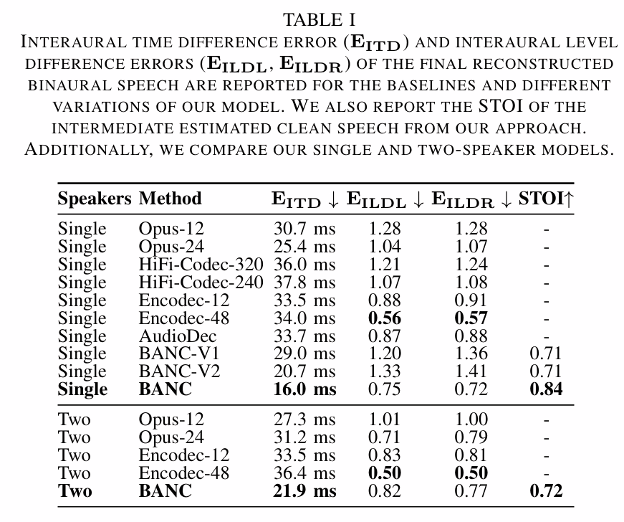
Results

Slide 16
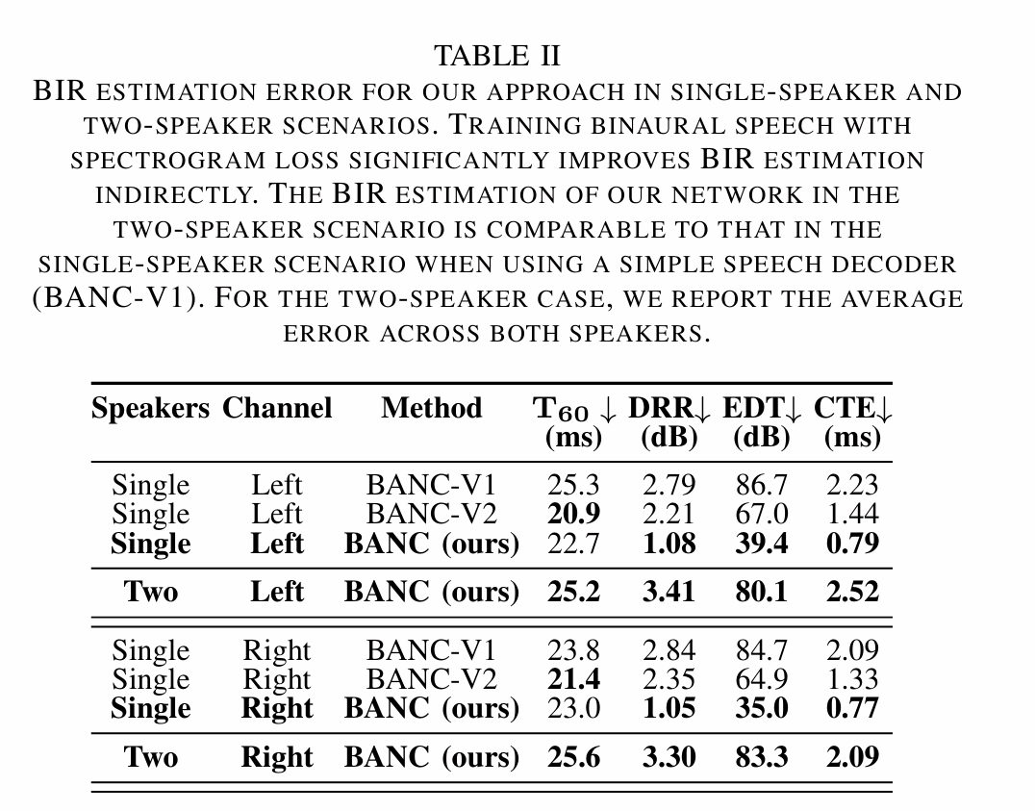
Results

Slide 17
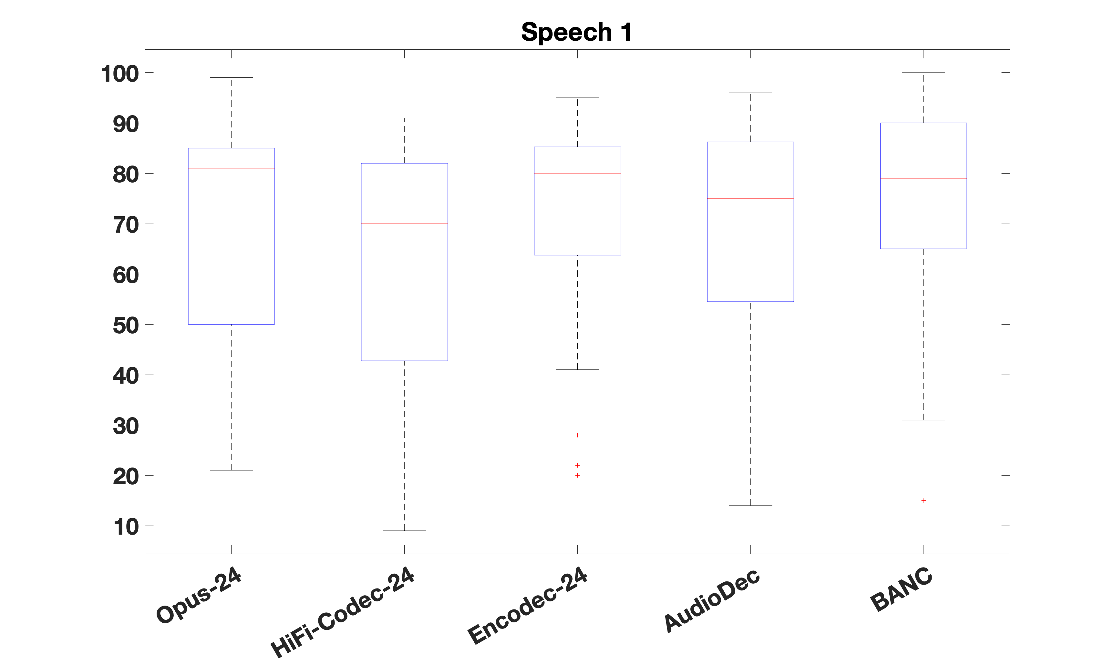
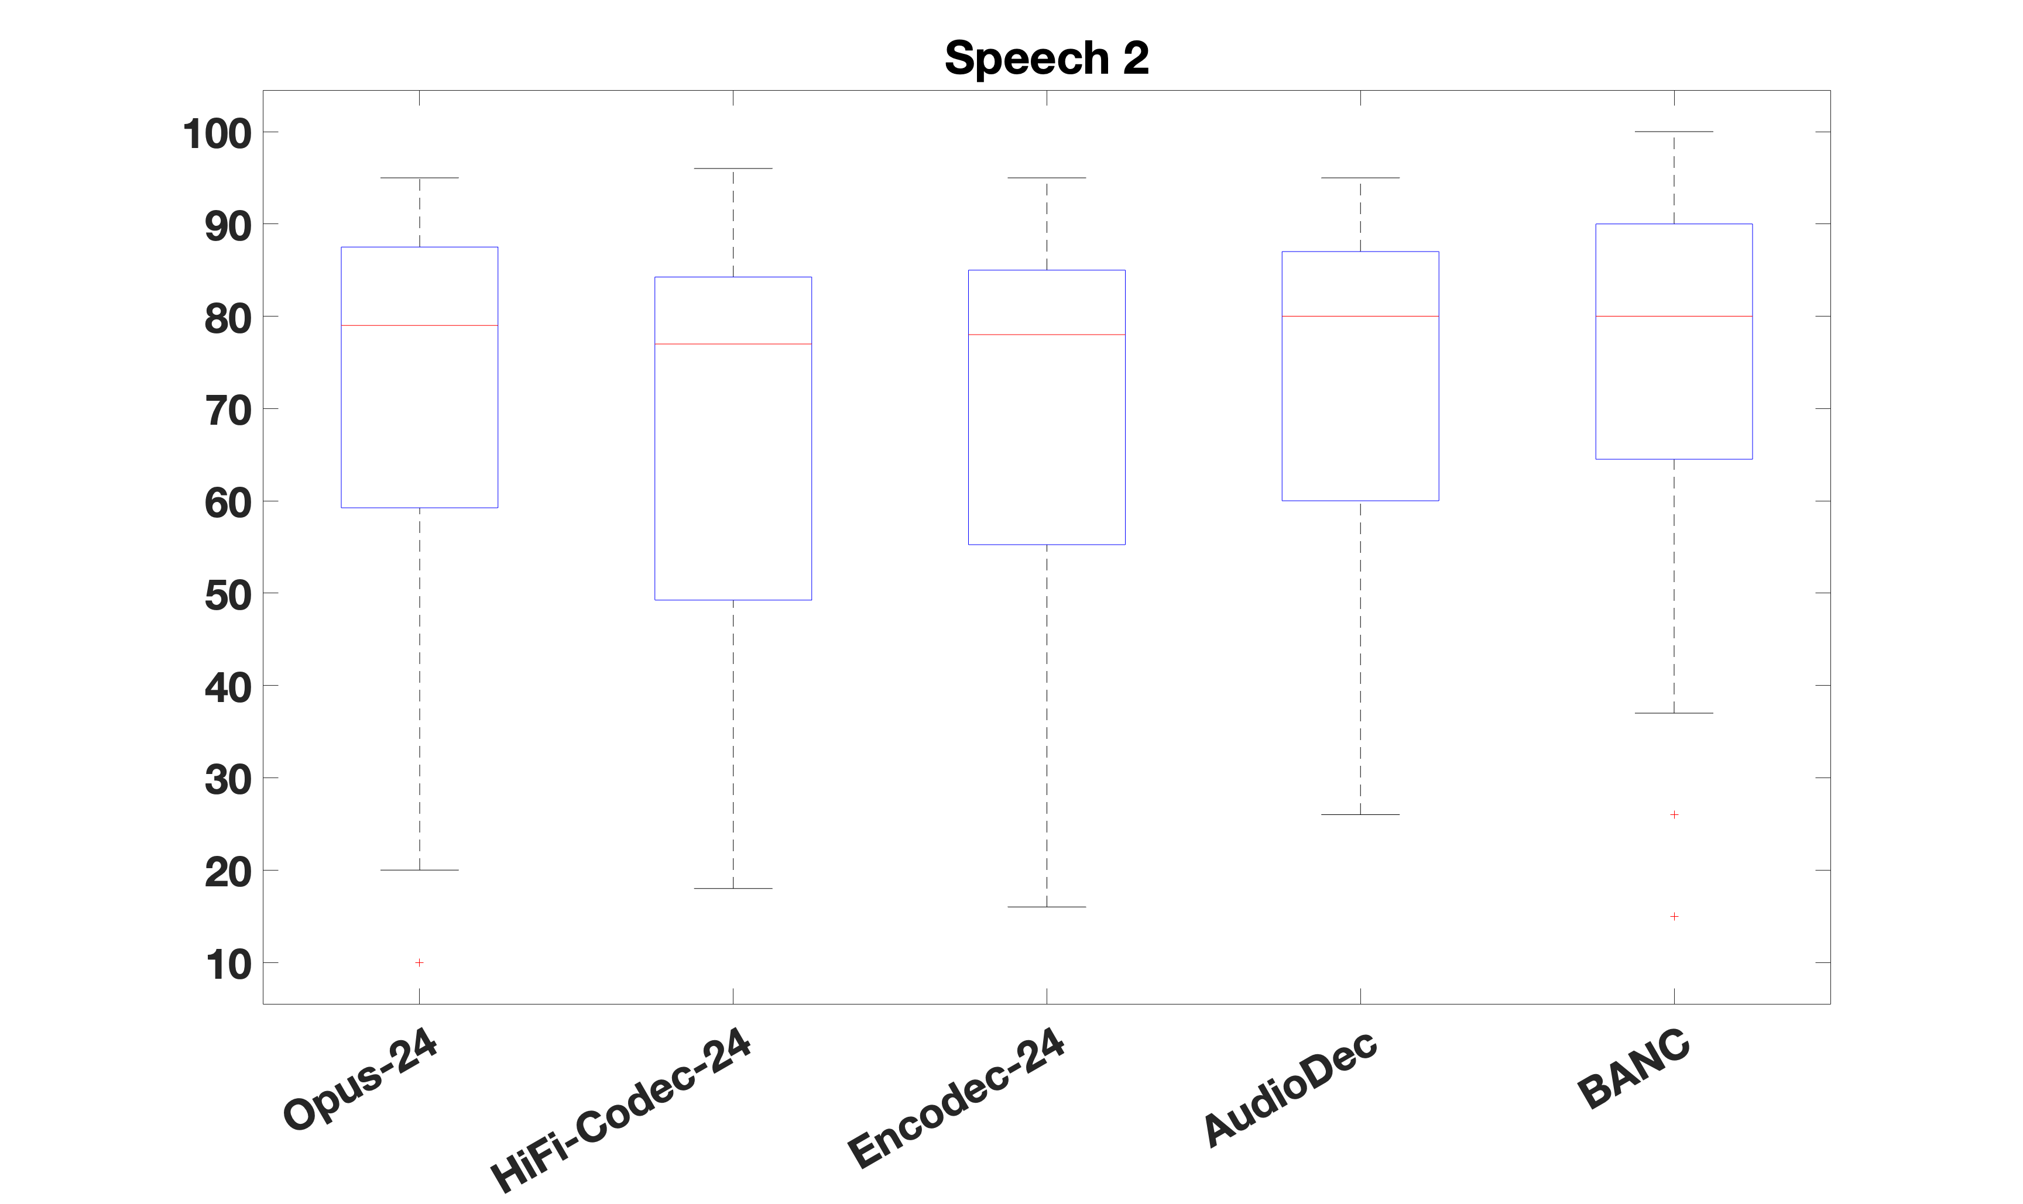
Perceptual Evaluation – Single Speaker
Box plot for reverberant speech 1
Box plot for reverberant speech 2

Slide 18
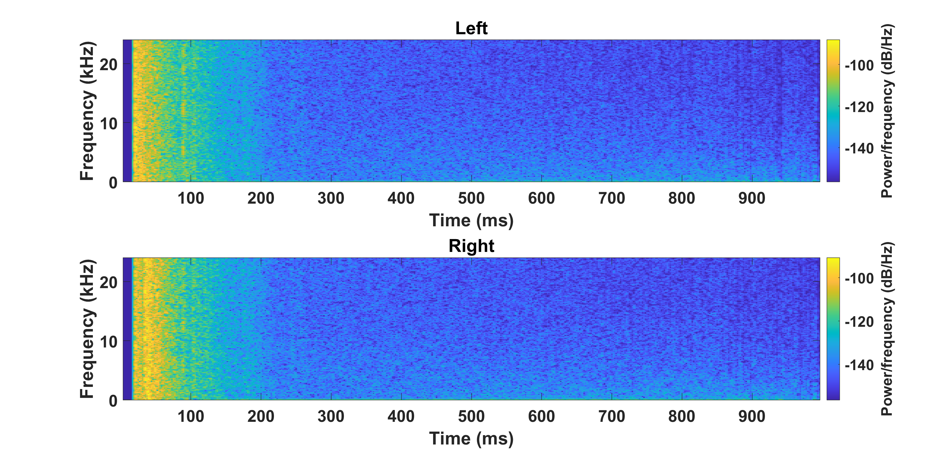
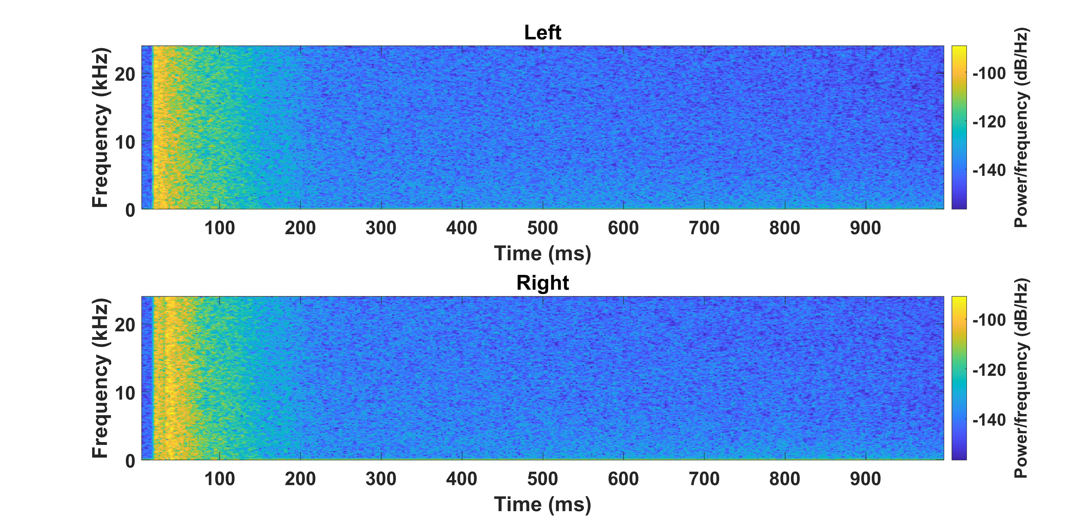
Binaural Impulse Response – Single Speaker
Spectrogram of Ground truth BIR
Spectrogram of Estimated BIR
Energy distribution of estimated binaural impulse response closely matches the ground truth binaural impulse response.

Slide 19

Audio Demo – Single Speaker
 | Binaural Speech Sample 1 | Binaural Speech Sample 2
Ground Truth
BANC (Our)

Slide 20
Audio Demo – Two Speaker
Clean Speech 1 | Clean Speech 2 | Ground Truth Binaural Speech | Binaural Speech from BANC

Slide 21
Conclusion
We propose BANC, a novel binaural neural audio codec for single-speaker speech and two-speaker spatially overlapped speech. Our approach outperforms traditional methods and neural audio codec with similar bandwidth, preserving binaural acoustic effects by up to 52%.
We introduce a novel technique to compress speech content and acoustic effects separately, demonstrating that our method can reduce the bandwidth for compressing binaural speech by 48% compared to compressing each channel individually using AudioDec.

Slide 22
Future work
Given the complexity of the scenario and the need for headphone-based evaluation, we have tested our approach on binaural two-speaker spatially overlapped speech.
In the future, we aim to extend it to compress and decode overlapped speech from multiple speakers in arbitrary locations.

